Slide 1
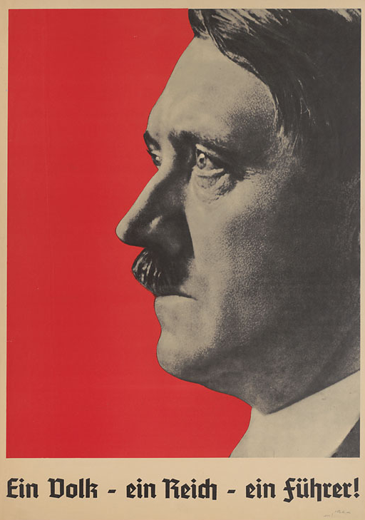
Why were the Nazis able to stay in power, 1933-39?
The establishment of a totalitarian state: “EIN VOLK, EIN REICH, EIN FŰHRER”

Slide 2
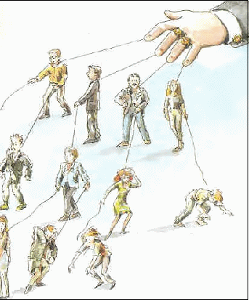
Gleichschaltung
One of the ways in which the Nazi Party was able to stay in power from 1933-39 was through the establishment of a totalitarian state in Germany.
What characteristics would you see in a totalitarian state?
One of the ways in which the Nazi Party were able to establish a totalitarian state was through adopting a policy of Gleichschaltung.

Slide 3
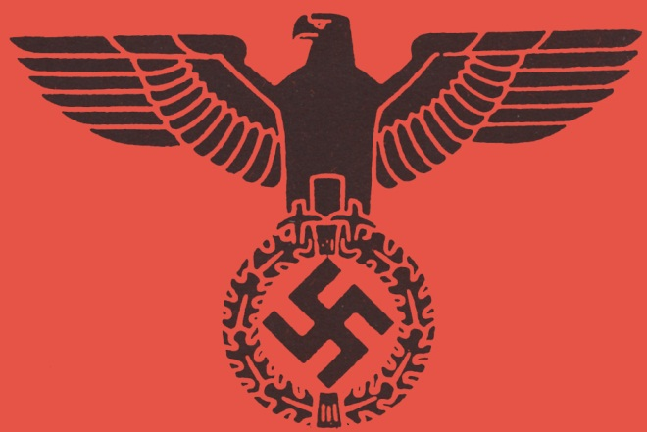
Definition: Gleichschaltung
Gleichschaltung means “co-ordination” “making the same” “bringing into line”.
It was the process of ensuring that the people of Germany were “nazified” i.e. that all Germans would accept and embody Nazi values.

Slide 4
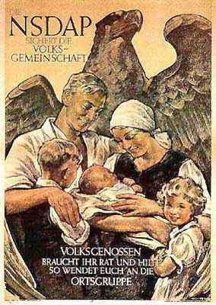
Gleichschaltung
Part of Gleichschaltung was also about building a “people’s community”, or Volksgemeinschaft.
Here, Germans were encouraged to have the same ideals and to work together for the good of the whole German community.
Goebbels once said: “You are nothing; the Volk (people) is everything”.

Slide 5
Gleichschaltung
In order to carry out this gleichschaltung, or “nazifying”, of the German population, it was essential that all organisations and groups in Germany were quickly brought into line with the Party.
No independent structures were allowed to continue.
Why?
They could become the focus of resistance.

Slide 6
Political parties
The Nazis used the powers given by the Enabling Act to get rid of any group which opposed them.
The first groups to be targeted where the left-wing political parties along with trade unions.
The Social Democratic Party (SPD) were banned on the 22 June 1933.

Slide 7
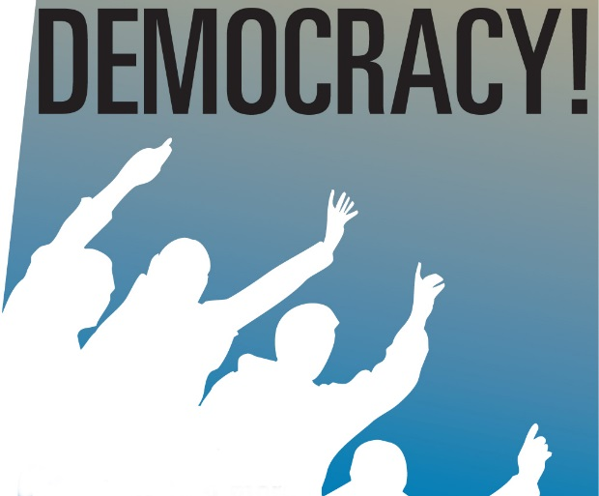
Political parties
The Communist Party were not banned officially as by this stage most of its members were either dead, in concentration camps, or had left Germany.
Most other parties more or less willingly disbanded in June.
The last party to go was the Centre Party which dissolved itself on 5 July.
On 14 July 1933 the Nazi Party was decreed to be the only legal political party.

Slide 8
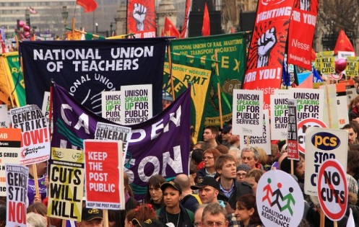
Trade Unions
Trade unions were banned by decree on 2 May 1933.
Once trade unions were banned no worker or organisation was permitted to strike.
Unions were considered to be Communist controlled – Nazi opponents within the TU movement were arrested and sent to Dachau concentration camp.
The Reich Labour Front was established to ‘protect the interests of the workers’.
The Labour Front was given power to fix wages.

Slide 9

Religion & The Churches
In July 1933 Hitler reached an agreement with the Catholic Church.
The Catholic Church was guaranteed religious freedom and the right to run their own affairs without state interference.
In return, they agreed not to interfere in politics.

Slide 10
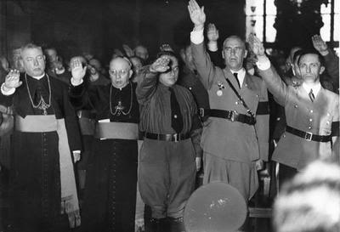
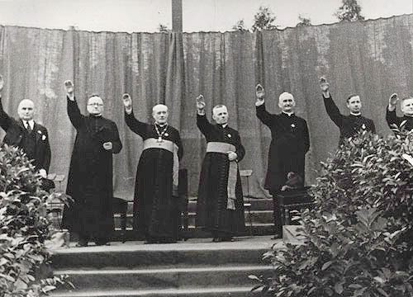
Vatican Clergy with Nazi officials Wilhelm Frick and Joseph Goebbels
Priests giving the Hitler salute at a Catholic youth rally in the Berlin-Neukolln stadium in August 1933.

Slide 11
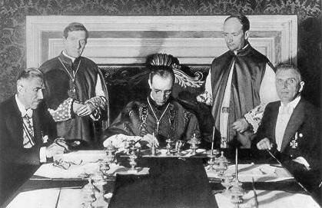
The Concordat between the Vatican and the Nazis.
Cardinal Secretary of State, Eugenio Pacelli (later to become Pope Pius XII) signs the Concordat between Nazi Germany and the Vatican at a formal ceremony in Rome on 20 July 1933.
Nazi Vice-Chancellor Franz von Papen sits at the left, Pacelli in the middle.

Slide 12
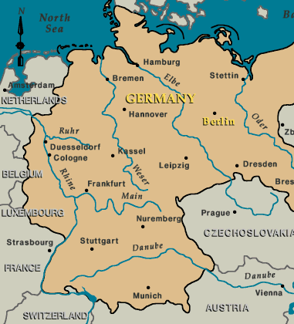
Abolition of state governments
Hitler and the Nazis wanted to ensure that power was centralised in Berlin.
Initially, the leaders of state governments were dismissed and replaced by leading local Nazis.
However, in January 1934 state governments were put under direct control of the Reich Government.

Slide 13
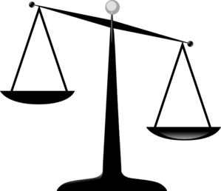
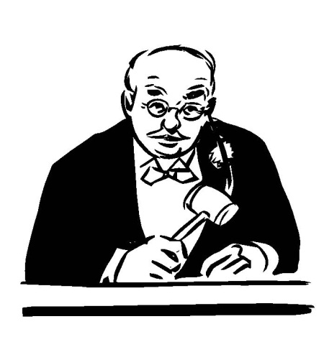
The Courts & Legal System
The Nazis passed new laws reflecting the Nazis’ political views.
Judges were now expected to interpret all laws according to Nazi values.
“Everything which is useful for the nation is lawful; everything which harms it is unlawful.” Wilhelm Frick (Nazi Interior Minister)

Slide 14
The Courts & Legal System
Lawyers were co-ordinated in the German Lawyers Front.
In October 1933, 10,000 lawyers gave the Nazi salute and swore ‘by the souls of the German people… to strive as German jurists to follow the course of our Fuhrer to the end of our days.’
Under a new code, judges were to act ‘according to popular feeling’.

Slide 15
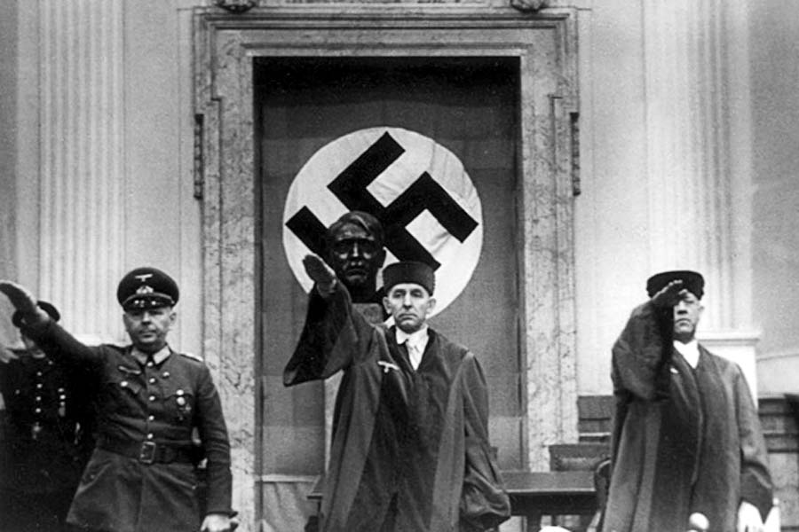
From 1936 the eagle and swastika had to be worn on judges’ robes
Judges in court making a Nazi salute

Slide 16
The Professions & Civil Service
During the first half of 1933 the professions were “synchronised”.
Professional organisations of doctors, lawyers, university and school teachers were reorganised under Nazi leaders.
One 7 April 1933 the Law for the Re-Establishment of the Professional Civil Service was passed.
This led to the dismissal of political opponents of the Nazis and Jews, around 5% of the Civil Service were purged.

Slide 17
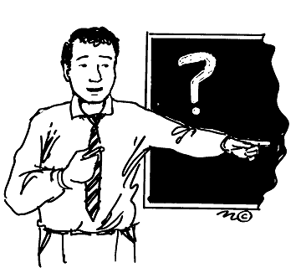
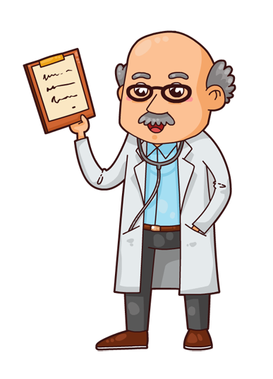
The Professions & Civil Service
By 1936 32% teachers and 45% doctors were members of the Party.
From 1939 it was compulsory for members of the Civil Service to join the Party.

